Slide 1
CS7015 (Deep Learning) : Lecture 7
Autoencoders and relation to PCA, Regularization in autoencoders, Denoising autoencoders, Sparse autoencoders, Contractive autoencoders
Mitesh M. Khapra
Department of Computer Science and Engineering Indian Institute of Technology Madras
CS7015 (Deep Learning) : Lecture 7

Slide 2
Module 7.1: Introduction to Autoencoders
CS7015 (Deep Learning) : Lecture 7

Slide 3






An autoencoder is a special type of feed forward neural network which does the following
xˆ_{i}
_{W} ∗
Encodes its input x into a hidden
i
h
representation h
Decodes the input again from this hidden representation
The model is trained to minimize a certain loss function which will ensure that xˆ_{i} is close to x_{i} (we will see some such loss functions soon)
W
x_{i}
h = g(W x_{i} + b)
xˆ_{i} = f (W ∗h + c)
3/55
CS7015 (Deep Learning) : Lecture 7

Slide 4




Let us consider the case where dim(h) < dim(x_{i})
xˆ_{i}
_{W} ∗
If we are still able to reconstruct xˆ_{i} perfectly from h, then what does it say about h?
h is a loss-free encoding of x_{i}. It cap- tures all the important characteristics of x_{i}
Do you see an analogy with PCA?
h
W
x_{i}
h = g(W x_{i} + b)
xˆ_{i} = f (W ∗h + c)
An autoencoder where dim(h) < dim(x_{i}) is called an under complete autoencoder
4/55
CS7015 (Deep Learning) : Lecture 7

Slide 5
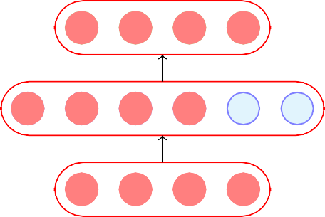
Let us consider the case when dim(h) ≥ dim(x_{i})
In such a case the autoencoder could learn a trivial encoding by simply copying x_{i} into h and then copying h into xˆ_{i}
Such an identity encoding is useless in practice as it does not really tell us anything about the important char- acteristics of the data
xˆ_{i}
_{W} ∗
h
W
x_{i}
h = g(W x_{i} + b)
xˆ_{i} = f (W ∗h + c)
An autoencoder where dim(h) ≥ dim(x_{i}) is called an over complete autoencoder
5/55
CS7015 (Deep Learning) : Lecture 7

Slide 6
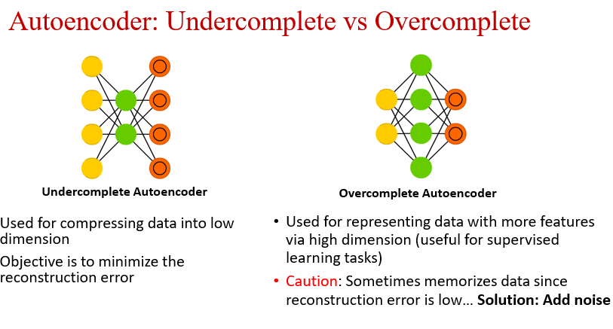

Slide 7
The Road Ahead
Choice of f (x_{i}) and g(x_{i}) Choice of loss function
CS7015 (Deep Learning) : Lecture 7

Slide 8
Suppose all our inputs are binary (each x_{ij} ∈ {0, 1})
xˆ_{i} = f (W ∗h + c)
_{W} ∗
Which of the following functions would be most apt for the decoder?
h = g(W x_{i} + b)
xˆ_{i} = tanh(W ∗h + c)
xˆ_{i} = W ∗h + c
xˆ_{i} = logistic(W ∗h + c)
Logistic as it naturally restricts all outputs to be between 0 and 1
W
x_{i}
0
1
1
0
1 ^{(binary inputs)}
g is typically chosen as the sigmoid function
8/55
CS7015 (Deep Learning) : Lecture 7

Slide 9
Suppose all our inputs are real (each
x_{ij} ∈ R)
xˆ_{i} = f (W ∗h + c)
_{W} ∗
Which of the following functions would be most apt for the decoder?
h = g(W x_{i} + b)
xˆ_{i} = tanh(W ∗h + c)
xˆ_{i} = W ∗h + c
W
x_{i}
xˆ = logistic(W ∗h + c)
i
0.25 0.5 1.25 3.5 4.5
(real valued inputs)
Again, g is typically chosen as the sigmoid function
What will logistic and tanh do?
They will restrict the reconstruc- ted xˆ_{i} to lie between [0,1] or [-1,1] whereas we want xˆ_{i} ∈ R^{n}
9/55
CS7015 (Deep Learning) : Lecture 7

Slide 10
The Road Ahead
Choice of f (x_{i}) and g(x_{i}) Choice of loss function
CS7015 (Deep Learning) : Lecture 7

Slide 11


Consider the case when the inputs are real valued
xˆ_{i}
_{W} ∗
The objective of the autoencoder is to recon- struct xˆ_{i} to be as close to x_{i} as possible
This can be formalized using the following objective function:
h
W
Σ Σ
1
m n
2
^{min (xˆ}ij ^{− x}ij ⁾
x_{i}
^{W,W ∗ ,c,b} m
i=1 j=1
Σ
1
m
i.e., min
T
h = g(W x + b)
(xˆ − x ) (xˆ − x )
i
^{W,W ∗ ,c,b} m
i i i i
xˆ_{i} = f (W ∗h + c)
i=1
We can then train the autoencoder just like a regular feedforward network using back- propagation
All we need is a formula for ^{∂L (θ)} and ^{∂L (θ)}
which we will see now
∂W ∗ ∂W
11/55
CS7015 (Deep Learning) : Lecture 7

Slide 12
∂L (θ) ₌ ∂L (θ)
∂W ∗ ∂h₂
L (θ) = (xˆ_{i} − x_{i})^{T} (xˆ_{i} − x_{i})
∂h₂ ∂a₂
∂a₂ ∂W ∗
^{h}2 ^{= xˆ}i
a₂
∂L (θ) ₌ ∂L (θ)
∂W ∂h₂
∂h₂ ∂a₂ ∂h₁ ∂a₁
∂a₂ ∂h₁ ∂a₁ ∂W
_{W} ∗
^{h}1
a₁
We have already seen how to calculate the expres-
sion in the boxes when we learnt backpropagation
W
∂L (θ) ₌ ∂L (θ)
∂h₂ ∂xˆ_{i}
^{h}0 ^{= x}i
T
= ∇ {(xˆ − x ) (xˆ − x )}
xˆ i i i i
i
Note that the loss function is shown for only one training example.
= 2(xˆ_{i} − x_{i})
12/55
CS7015 (Deep Learning) : Lecture 7

Slide 13
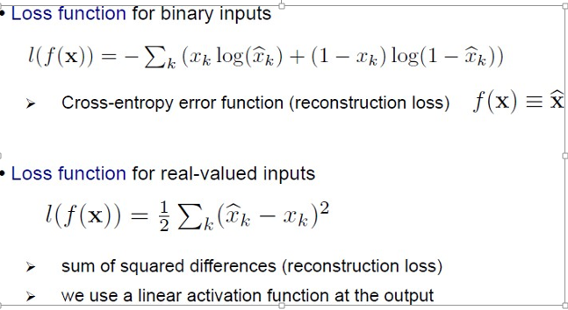

Slide 14
Module 7.3: Regularization in autoencoders (Motivation)
CS7015 (Deep Learning) : Lecture 7

Slide 15
While poor generalization could hap- pen even in undercomplete autoen- coders it is an even more serious prob- lem for overcomplete auto encoders
Here, (as stated earlier) the model can simply learn to copy x_{i} to h and then h to xˆ_{i}
To avoid poor generalization, we need to introduce regularization
xˆ_{i}
_{W} ∗
h
W
x_{i}
24/55
CS7015 (Deep Learning) : Lecture 7

Slide 16
The simplest solution is to add a L₂- regularization term to the objective function
xˆ_{i}
_{W} ∗
m n
1
Σ Σ
h
min
2 2
(xˆ − x ) + λǁθǁ
θ,w,w∗,b,c m
ij ij
i=1 j=1
W
This is very easy to implement and just adds a term λW to the gradient
x_{i}
^{∂L (θ)} (and similarly for other para-
∂W
meters)
25/55
CS7015 (Deep Learning) : Lecture 7

Slide 17
xˆ_{i} | Another trick is to tie the weights of the encoder and decoder i.e., W ∗ = _{W}T
 | This effectively reduces the capacity
h | of Autoencoder and acts as a regular-
 | izer
x_{i}
_{W} ∗
W
26/55
CS7015 (Deep Learning) : Lecture 7

Slide 18
Module 7.4: Denoising Autoencoders
CS7015 (Deep Learning) : Lecture 7

Slide 19
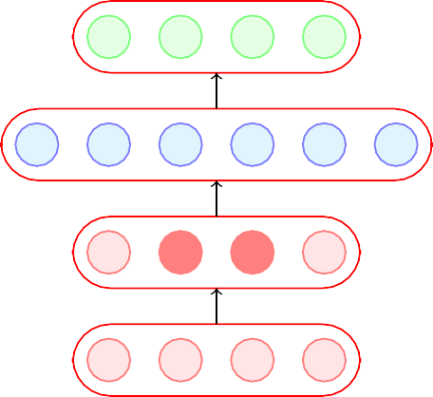
A denoising encoder simply corrupts the input data using a probabilistic
xˆ_{i}
process (P (x˜ |x )) before feeding it
ij ij
to the network
A simple P (x˜ |x ) used in practice
h
ij ij
is the following
P (x˜ = 0
|x ) = q
x˜
ij ij
i
P (x˜_{ij} = x_{ij} |x_{ij} ) = 1 − q
In other words, with probability q the input is flipped to 0 and with probab- ility (1 − q) it is retained as it is
P (x˜_{ij} |x_{ij} )
x_{i}
28/55
CS7015 (Deep Learning) : Lecture 7

Slide 20
How does this help ?
xˆ_{i}
This helps because the objective is still to reconstruct the original (un- corrupted) x_{i}
m n
h
1
m
Σ Σ
arg min
θ
(xˆ − x
₎2
ij
ij
i=1 j=1
x˜_{i}
It no longer makes sense for the model to copy the corrupted x˜ into h(x˜ )
i i
P (x˜_{ij} |x_{ij} )
and then into xˆ_{i} (the objective func-
x_{i}
tion will not be minimized by doing so)
For example, it will have to learn to reconstruct a corrupted x_{ij} correctly by relying on its interactions with other elements of x_{i}
Instead the model will now have to capture the characteristics of the data correctly.
29/55
CS7015 (Deep Learning) : Lecture 7

Slide 21
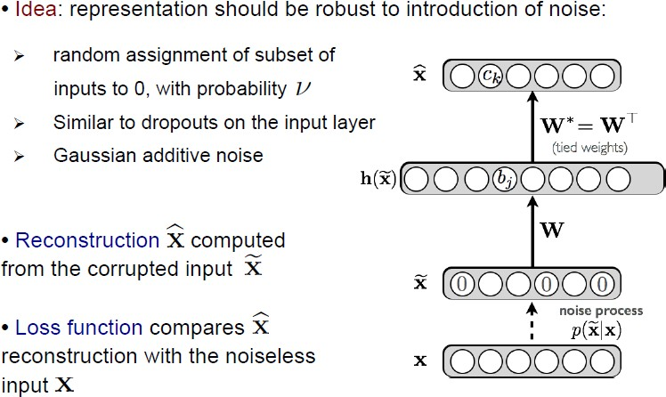
Denoising Autoencoder

Slide 22
We will now see a practical application in which AEs are used and then compare Denoising Autoencoders with regular autoencoders
CS7015 (Deep Learning) : Lecture 7

Slide 23


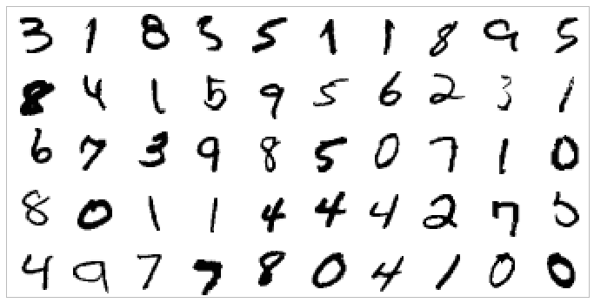

0
1
2
3 9
Task: Hand-written digit recognition
|x_{i}| = 784 = 28 × 28
28*28
Figure: Basic approach(we use raw data as input features)
Figure: MNIST Data
CS7015 (Deep Learning) : Lecture 7

Slide 24
xˆ_{i} ∈ R⁷⁸⁴
Task: Hand-written digit recognition
h ∈ R^{d}
|x_{i}| = 784 = 28 × 28
Figure: MNIST Data
Figure: AE approach (first learn important characteristics of data)
CS7015 (Deep Learning) : Lecture 7

Slide 25

Task: Hand-written digit recognition
0
1
2
3 9
h ∈ R^{d}
|x_{i}| = 784 = 28 × 28
Figure: MNIST Data
Figure: AE approach (and then train a classifier on top of this hidden representation)
CS7015 (Deep Learning) : Lecture 7

Slide 26
We will now see a way of visualizing AEs and use this visualization to compare different AEs
CS7015 (Deep Learning) : Lecture 7

Slide 27

We can think of each neuron as a filter which will fire (or get maximally) activated for a cer- tain input configuration x_{i}
xˆ_{i}
For example,
h
h₁ = σ(W^{T} x_{i}) [ignoring bias b]
1
Where W₁ is the trained vector of weights con- necting the input to the first hidden neuron
What values of x_{i} will cause h₁ to be max- imum (or maximally activated)
Suppose we assume that our inputs are nor- malized so that ǁx_{i}ǁ = 1
x_{i}
35/55
CS7015 (Deep Learning) : Lecture 7

Slide 28
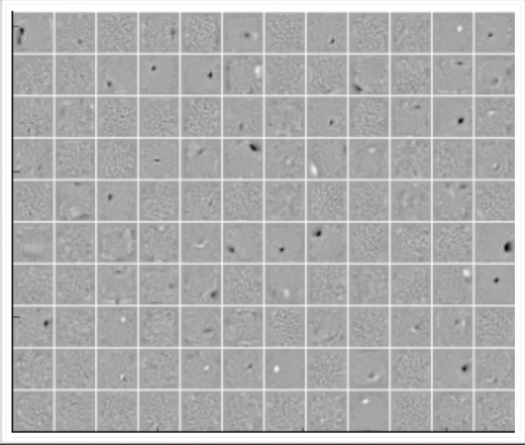
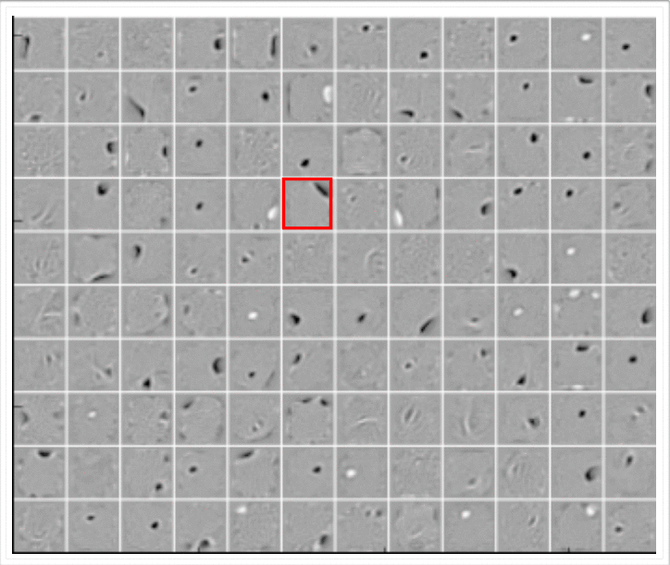
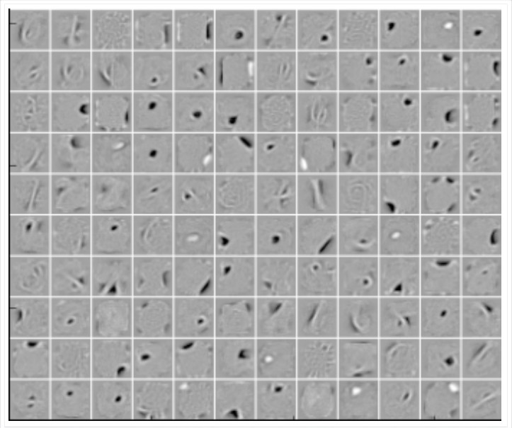
Figure: Vanilla AE (No noise)
Figure: 25% Denoising AE (q=0.25)
Figure: 50% Denoising AE (q=0.5)
The vanilla AE does not learn many meaningful patterns
The hidden neurons of the denoising AEs seem to act like pen-stroke detectors (for example, in the highlighted neuron the black region is a stroke that you would expect in a ’0’ or a ’2’ or a ’3’ or a ’8’ or a ’9’)
As the noise increases the filters become more wide because the neuron has to rely on more adjacent pixels to feel confident about a stroke
37/55
CS7015 (Deep Learning) : Lecture 7

Slide 29
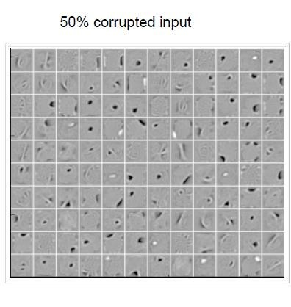
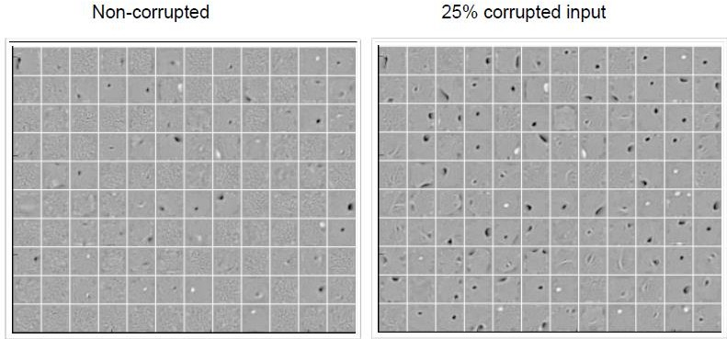
Corruption vs Learned Filters
More the corruption, filters are learned well
Caution: Too much corruption can lead to lower reconstruction

Slide 30
Denoising Autoencoder Applications
Input: Corrupted image patch
Output: HQ Reconstructed image patch

Slide 31
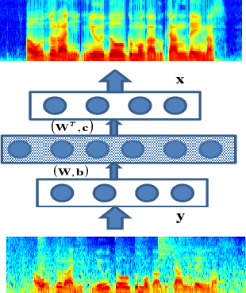
DAE for Speech Enhancement
Features: Raw audio or frequency features such as
STFT, MFCC, etc.
Training: DAE will get noisy audio as input and aim to construct noiseless audio as output
Testing: Noisy audio input will be processed where DAE will loose the noises in the latent representation and clean audio will come as output in decoder.
Data: Noisy and noiseless versions of same audio
What if you have only noiseless audio?
Solution: Add some noise through augmentation and generate
What if you have only noisy audio?
Solution: Manual/semi automated cleaning of audio
DAE based Speech Enhancer

Slide 32
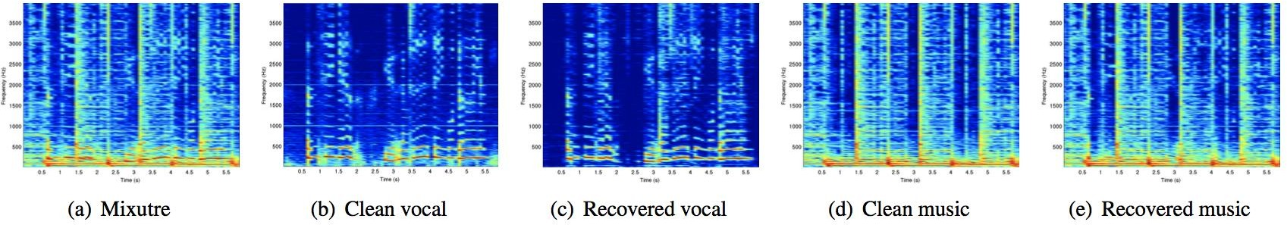
DAE for Music Voice Separation
Music can be model as noise where voice can be modelled as target
Or voice can be modelled as noise where music can be predicted as target
Recent Example: MaD TwinNet for music voice separation
Output of DAE that separates voice from music

Slide 33

We saw one form of P (x˜ |x ) which flips a
ij ij
xˆ
i
fraction q of the inputs to zero
Another way of corrupting the inputs is to add a Gaussian noise to the input
h
x˜ = x + N (0, 1)
ij ij
x˜_{i}
We will now use such a denoising AE on a
P (x˜_{ij} |x_{ij} )
x_{i}
different dataset and see their performance
38/55
CS7015 (Deep Learning) : Lecture 7

Slide 34
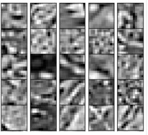
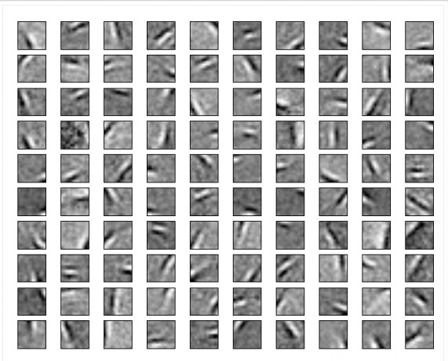
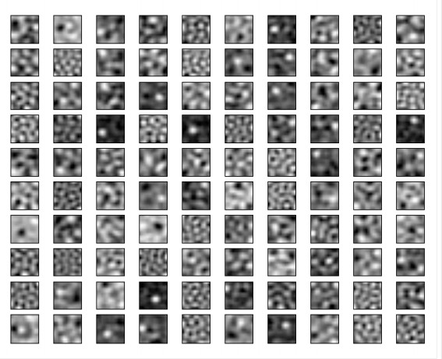
Figure: Weight decay filters
Figure: Data
Figure: AE filters
The hidden neurons essentially behave like edge detectors PCA does not give such edge detectors
39/55
CS7015 (Deep Learning) : Lecture 7

Slide 35
Module 7.5: Sparse Autoencoders
CS7015 (Deep Learning) : Lecture 7

Slide 36
A hidden neuron with sigmoid activation will have values between 0 and 1
We say that the neuron is activated when its output is close to 1 and not activated when its output is close to 0.
A sparse autoencoder tries to ensure the neuron is inactive most of the times.
xˆ_{i}
h
x_{i}
41/55
CS7015 (Deep Learning) : Lecture 7

Slide 37
If the neuron l is sparse (i.e. mostly inactive) then ρˆ_{l} → 0
xˆ_{i}
A sparse autoencoder uses a sparsity para- meter ρ (typically very close to 0, say, 0.005) and tries to enforce the constraint ρˆ_{l} = ρ
One way of ensuring this is to add the follow- ing term to the objective function
h
x_{i}
k
The average value of the activation of a neuron l is given by
m
Σ
ρ
1 − ρ
1 − ρˆ_{l}
Ω(θ) = ρ log + (1 − ρ) log
ρˆ_{l}
l=1
1
Σ
When will this term reach its minimum value and what is the minimum value? Let us plot it and check.
ρˆ =
h(x )
l
m
i l
i=1
42/55
CS7015 (Deep Learning) : Lecture 7

Slide 38
ρ = 0.2
Ω(θ)
0.2
ρˆ_{l}
43/55
CS7015 (Deep Learning) : Lecture 7

Slide 39
ρ = 0.2
Ω(θ)
0.2
ρˆ_{l}
The function will reach its minimum value(s) when ρˆ_{l} = ρ.
43/55
CS7015 (Deep Learning) : Lecture 7

Slide 40
Now,
Σ
k
ρ
1 − ρ
1 − ρˆ_{l}
Ω(θ) = ρlog + (1 − ρ)log
ρˆ_{l}
l=1
L^{ˆ}(θ) = L (θ) + Ω(θ)
Can be re-written as
Σ
L (θ) is the squared error loss or cross entropy loss and Ω(θ) is the sparsity constraint.
We already know how to calculate
∂L (θ)
∂W
k
Ω(θ) = ρlogρ−ρlogρˆ +(1−ρ)log(1−ρ)−(1−ρ)log(1−ρˆ )
l l
l=1
Let us see how to calculate ^{∂Ω(θ)} .
∂W
44/55
CS7015 (Deep Learning) : Lecture 7

Slide 41
Module 7.6: Contractive Autoencoders
CS7015 (Deep Learning) : Lecture 7

Slide 42
A contractive autoencoder also tries to prevent an overcomplete autoen- coder from learning the identity func- tion.
xˆ
It does so by adding the following reg- ularization term to the loss function
h
Ω(θ) = ǁJ (h)ǁ
2
x
F
x
where J_{x}(h) is the Jacobian of the en- coder.
Let us see what it looks like.
47/55
CS7015 (Deep Learning) : Lecture 7

Slide 43
If the input has n dimensions and the hidden layer has k dimensions then


∂h
1
. . . . . . . . .
. . . . . . . . .
. . .
. . . . . . . . .
∂h
1
∂x₁
^{∂x}n

∂h
2
∂h
2

J (h) =
∂x₁
^{∂x}n
x

.
.


.
∂h_{k}
∂x₁
.
∂h_{k}
^{∂x}n
48/55
CS7015 (Deep Learning) : Lecture 7

Slide 44
y
Consider the variations in the data along directions u₁ and u₂
It makes sense to maximize a neuron to be sensitive to variations along u₁
At the same time it makes sense to inhibit a neuron from being sensitive to variations along u₂ (as there seems to be small noise and unimportant for reconstruction)
By doing so we can balance between the contradicting goals of good recon- struction and low sensitivity.
What does this remind you of ?
u₁
u₂
x
52/55
CS7015 (Deep Learning) : Lecture 7

Slide 45
Module 7.7 : Summary
CS7015 (Deep Learning) : Lecture 7

Slide 46
Regularization
xˆ_{i}
h
2
Ω(θ) = λǁθǁ
Weight decaying
Σ
k
ρ 1 − ρ
Ω(θ) = ρ log + (1 − ρ) log
Sparse
ρˆ_{l} 1 − ρˆ_{l}
x˜_{i}
l=1
Σ Σ
n k
∂h
2
Ω(θ) =
l
Contractive
P (x˜_{ij} |x_{ij} )
^{∂x}j
j=1 l=1
x_{i}
55/55
CS7015 (Deep Learning) : Lecture 7

